Slide 1
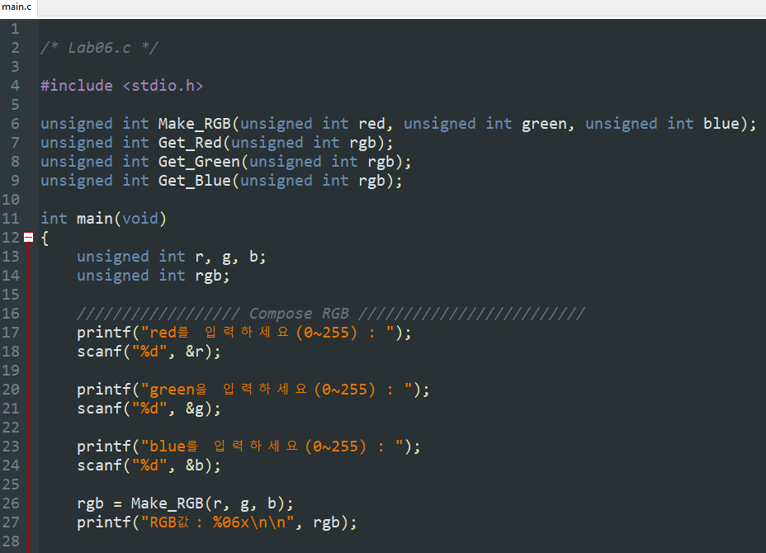
Chapter 6 Solution
실전과제 (1/3)

Slide 2
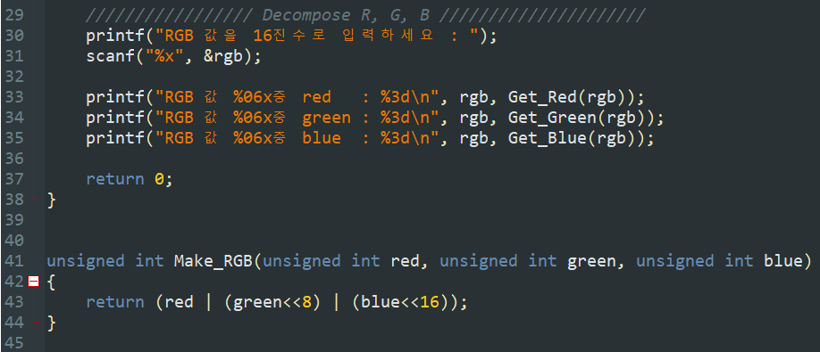
Chapter 6 Solution
실전과제 (2/3)

Slide 3
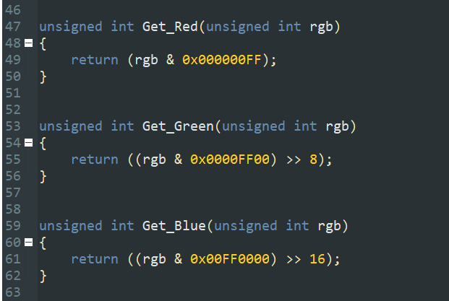
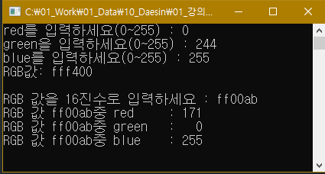
Chapter 6 Solution
실전과제 (3/3)

Slide 4
Chapter 6 Solution
연습문제
Num | Sol
1 | ①, ③
2 | ④
3 | ②, ③
4 | C-A-E-D-G-F-B
5 | ①, ④
6 | Scope rule ( 변수의 영역규칙)
Num | Sol
7 | Global variable ( 전역변수)
8 | Passing by value (Call by value)
9 | ①
10 | ⑤
11 | double GetLength(int x1, int y1, int x2, int y2);
12 | dummy = 17.250000

Slide 5
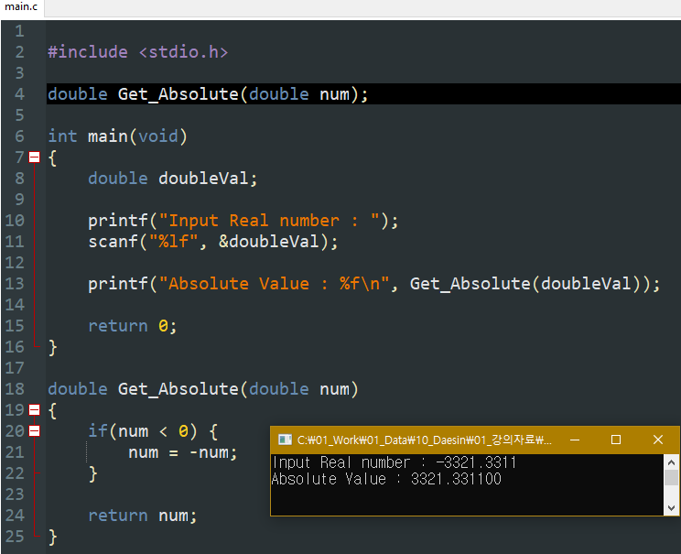
Chapter 6 Solution
연습문제 13

Slide 6
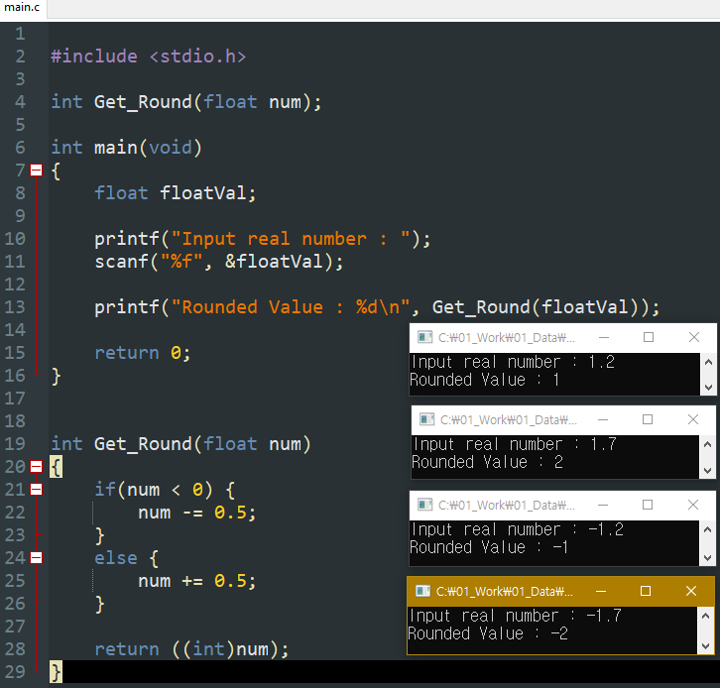
Chapter 6 Solution
연습문제 14

Slide 7
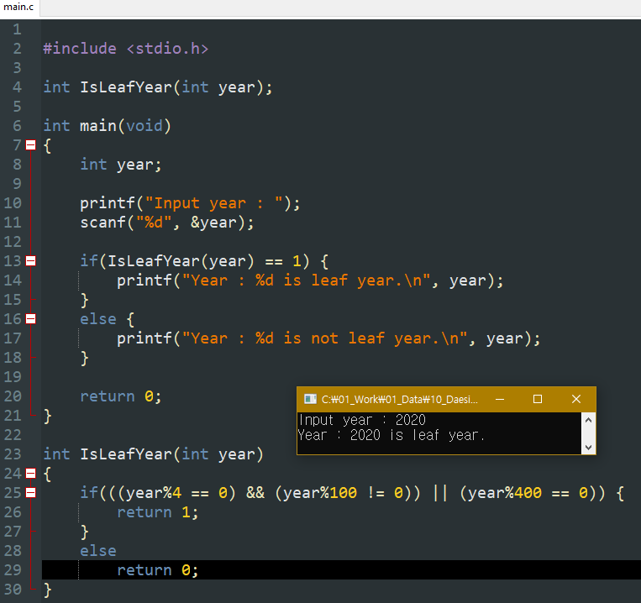
Chapter 6 Solution
연습문제 15

Slide 8
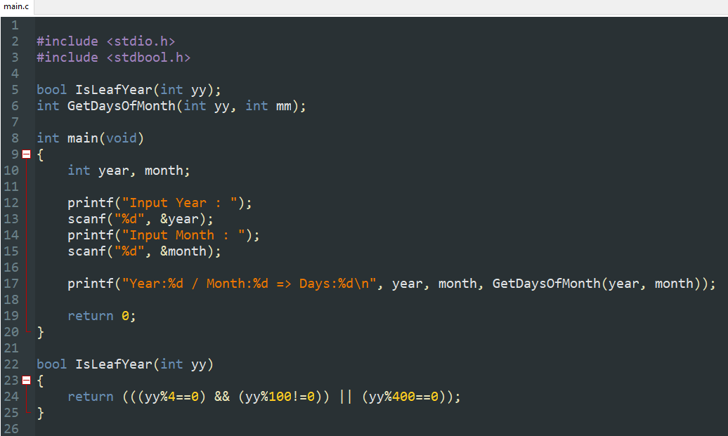
Chapter 6 Solution
연습문제 16 (1/2)

Slide 9
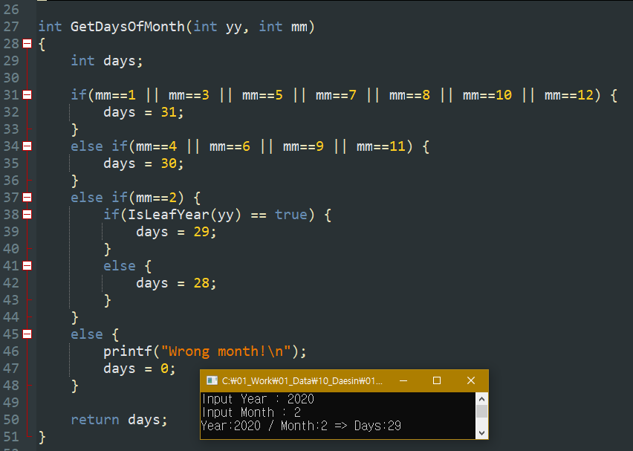
Chapter 6 Solution
연습문제 16 (2/2)

Slide 10
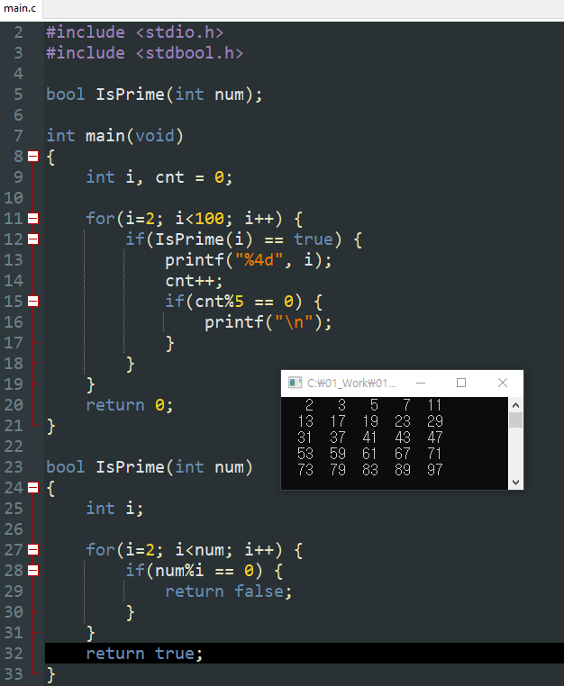
Chapter 6 Solution
연습문제 17

Slide 11
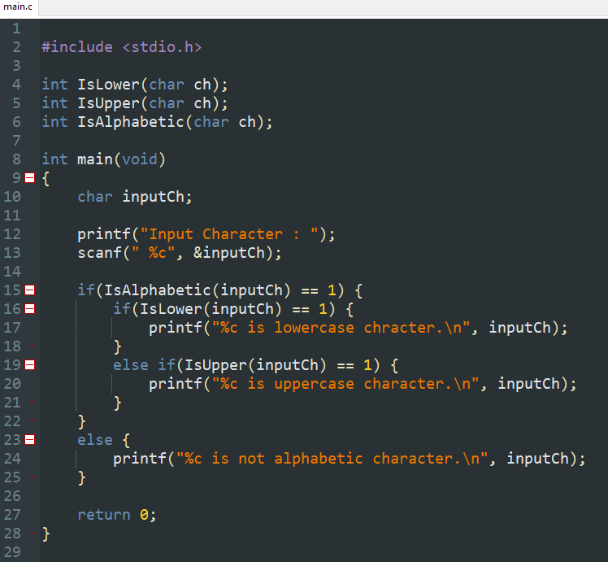
Chapter 6 Solution
연습문제 18
(1/2)

Slide 12
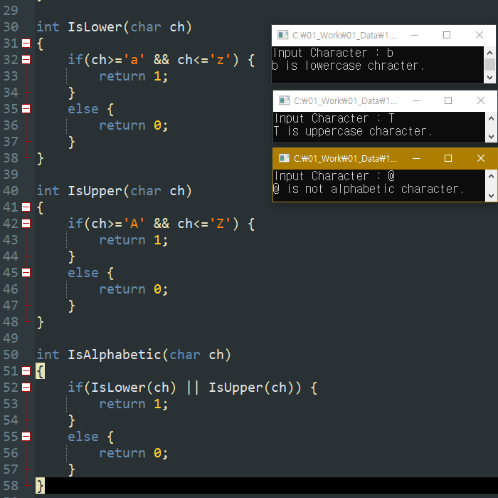
Chapter 6 Solution
연습문제 18
(2/2)

Slide 13
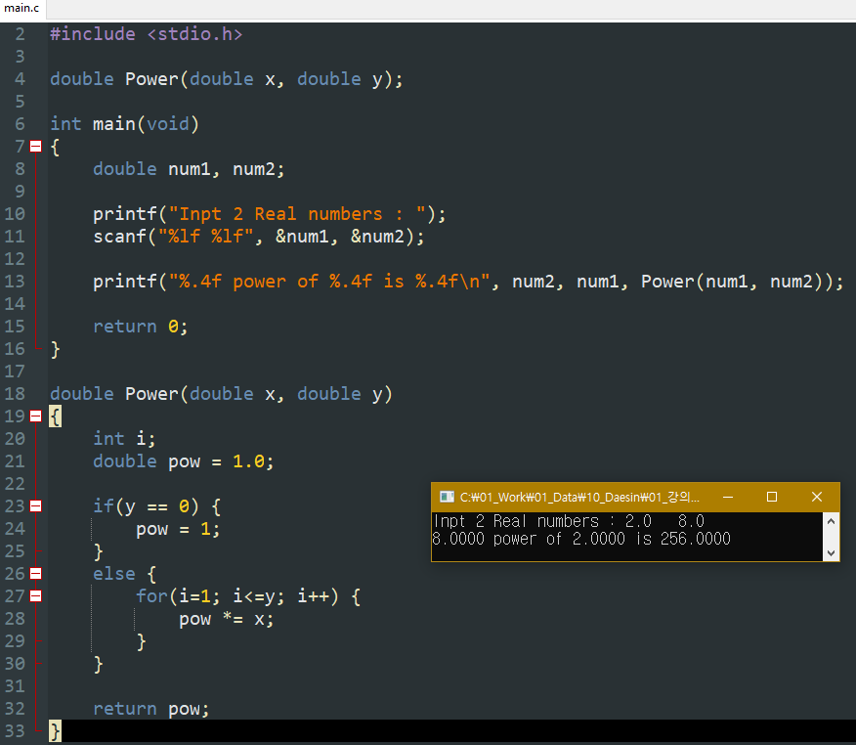
Chapter 6 Solution
연습문제 19

Slide 14
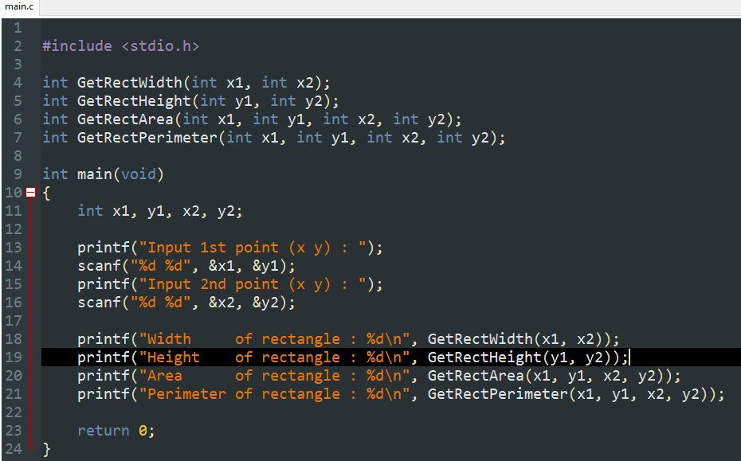
Chapter 6 Solution
연습문제 20 (1/3)

Slide 15
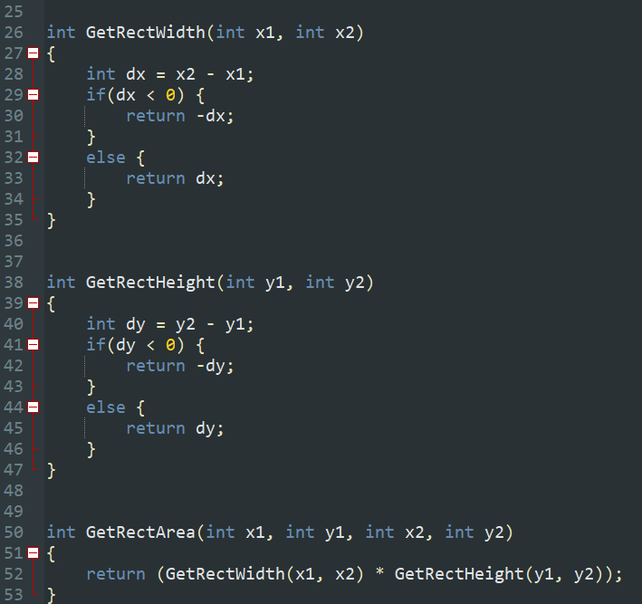
Chapter 6 Solution
연습문제 20 (2/3)

Slide 16
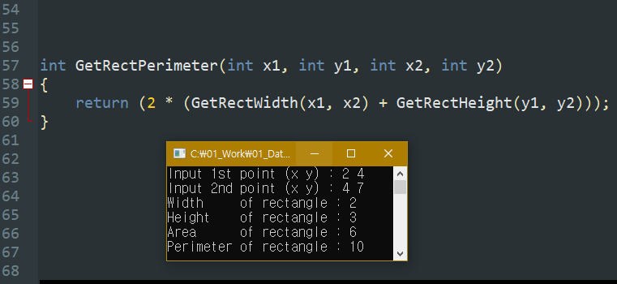
Chapter 6 Solution
연습문제 20 (3/3)

